Slide 1

Si te gusta la estadística bancate los metámeros
Elio Campitelli
 eliocamp
 d_olivaw

Slide 2
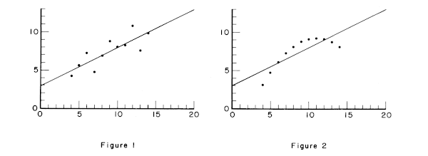
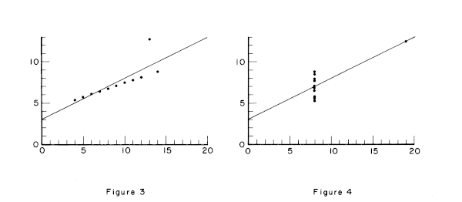
Anscombe, F. J.
“Graphs in Statistical Analysis”. The American Statistician 27, nº 1 (1973): 17–21.

Slide 3
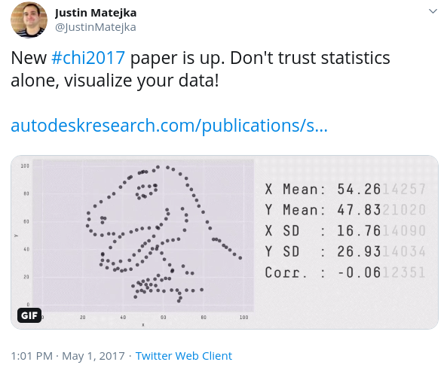
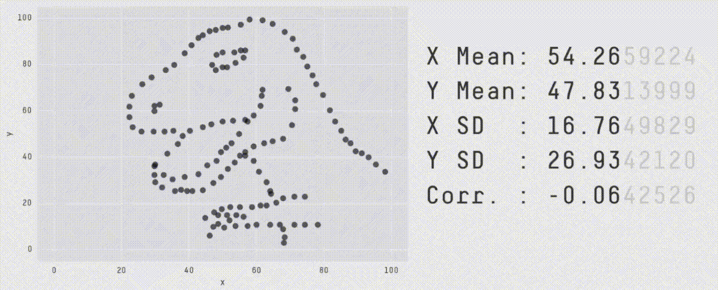
Matejka, Justin, y George Fitzmaurice.
“Same Stats, Different Graphs: Generating Datasets with Varied Appearance and Identical Statistics through Simulated Annealing”.

Slide 4


Jamie Wong, Color: From Hexcodes to Eyeballs.
http://jamie-wong.com/post/color/

Slide 5
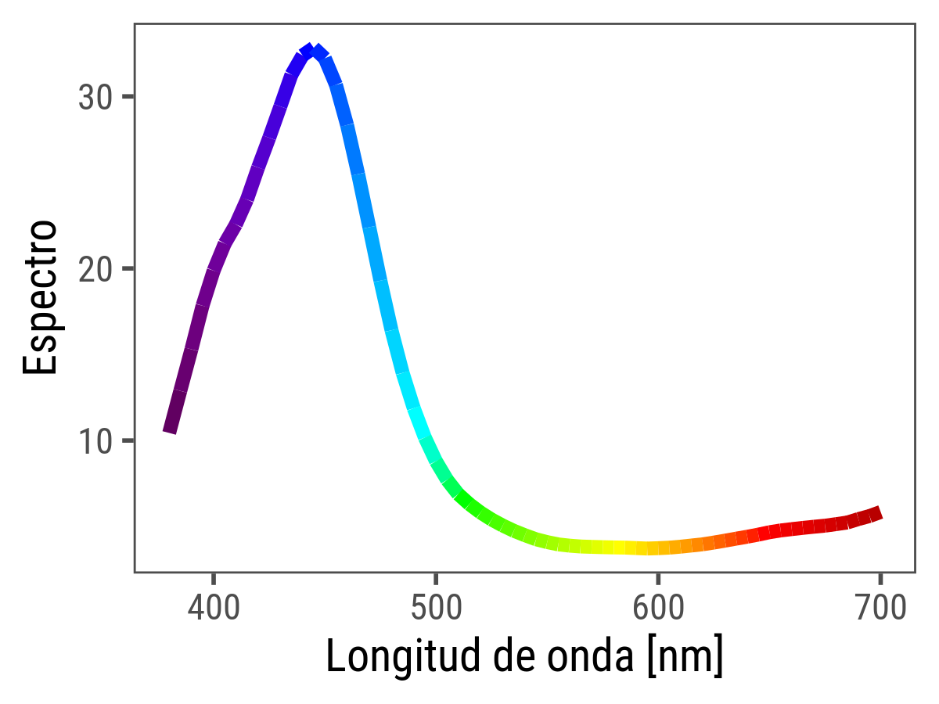
Jamie Wong, Color: From Hexcodes to Eyeballs.
http://jamie-wong.com/post/color/

Slide 6

Jamie Wong, Color: From Hexcodes to Eyeballs.
http://jamie-wong.com/post/color/

Slide 7

Jamie Wong, Color: From Hexcodes to Eyeballs.
http://jamie-wong.com/post/color/

Slide 8
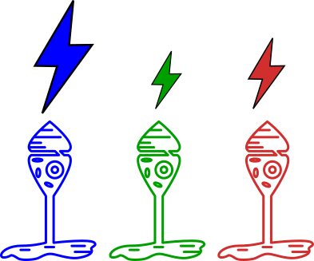
Jamie Wong, Color: From Hexcodes to Eyeballs.
http://jamie-wong.com/post/color/

Slide 9
Jamie Wong, Color: From Hexcodes to Eyeballs.
http://jamie-wong.com/post/color/

Slide 10

Jamie Wong, Color: From Hexcodes to Eyeballs.
http://jamie-wong.com/post/color/

Slide 11
METAMEROS

Slide 12
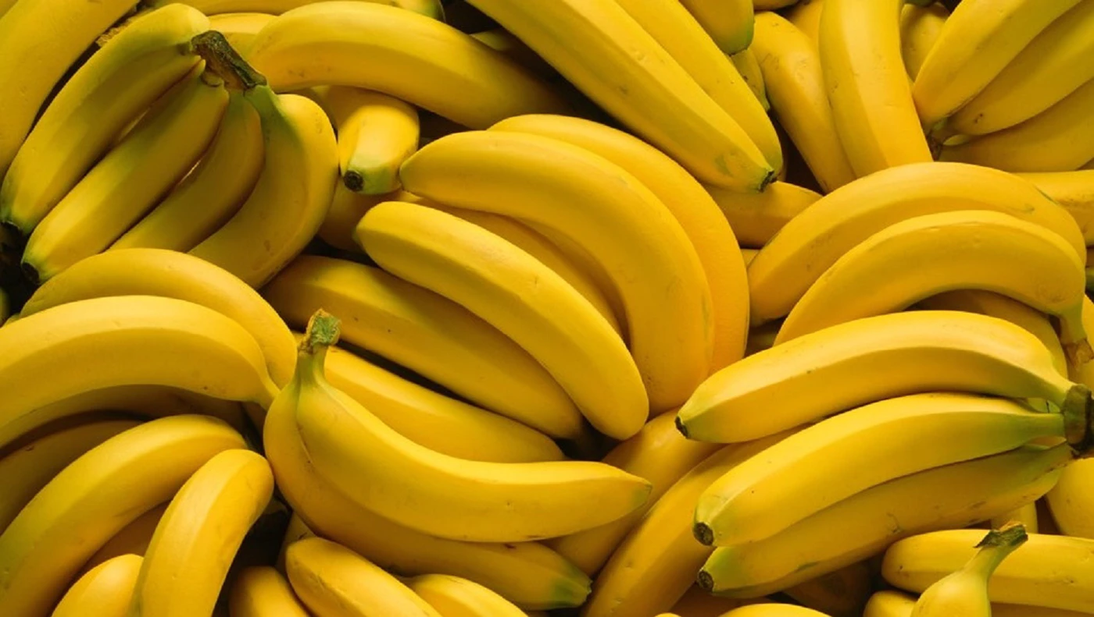
C’est ne pas una banana.

Slide 13



Slide 14


Slide 15

T = 15°C

Slide 16


Slide 18
La estadística busca reducir los datos a la mínima cantidad de información necesaria.

Slide 19
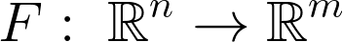
F es continua
F es inyectiva
m < n

Slide 21

F es continua
F es inyectiva
m < n

Slide 22
F es continua
Transformaciones
estadísticas
F es inyectiva
m < n

Slide 24
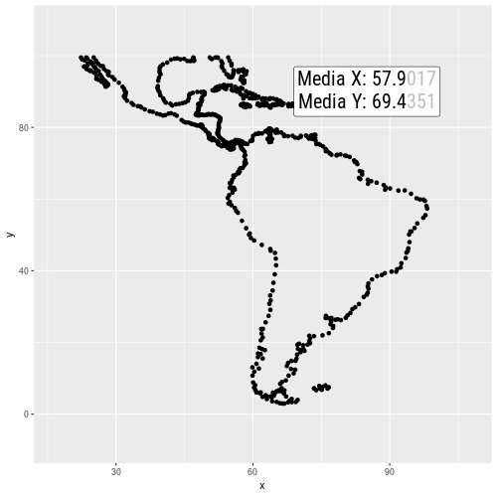

Slide 25
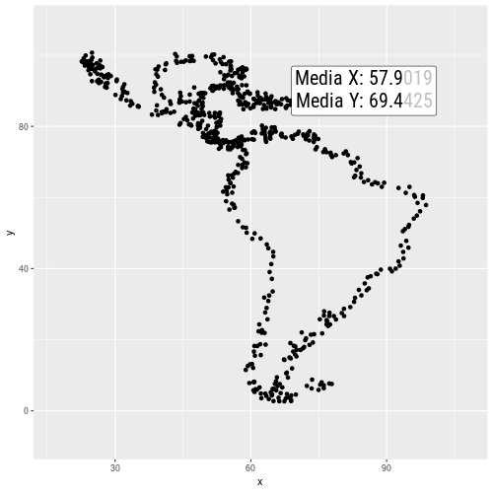

Slide 26
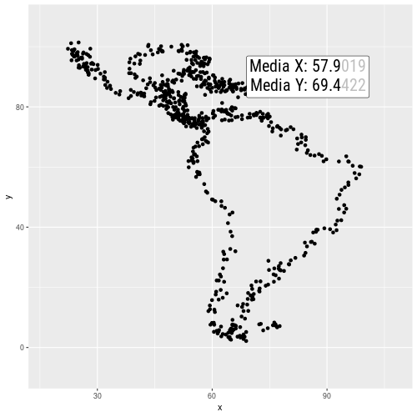

Slide 27


Slide 28
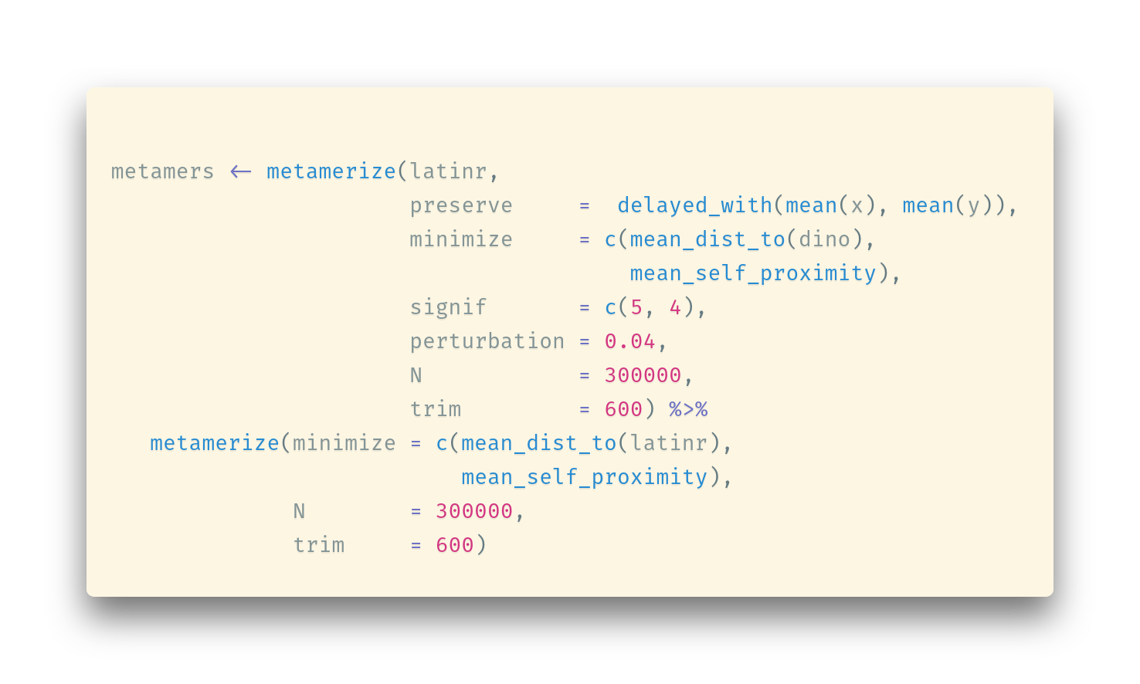

Slide 29
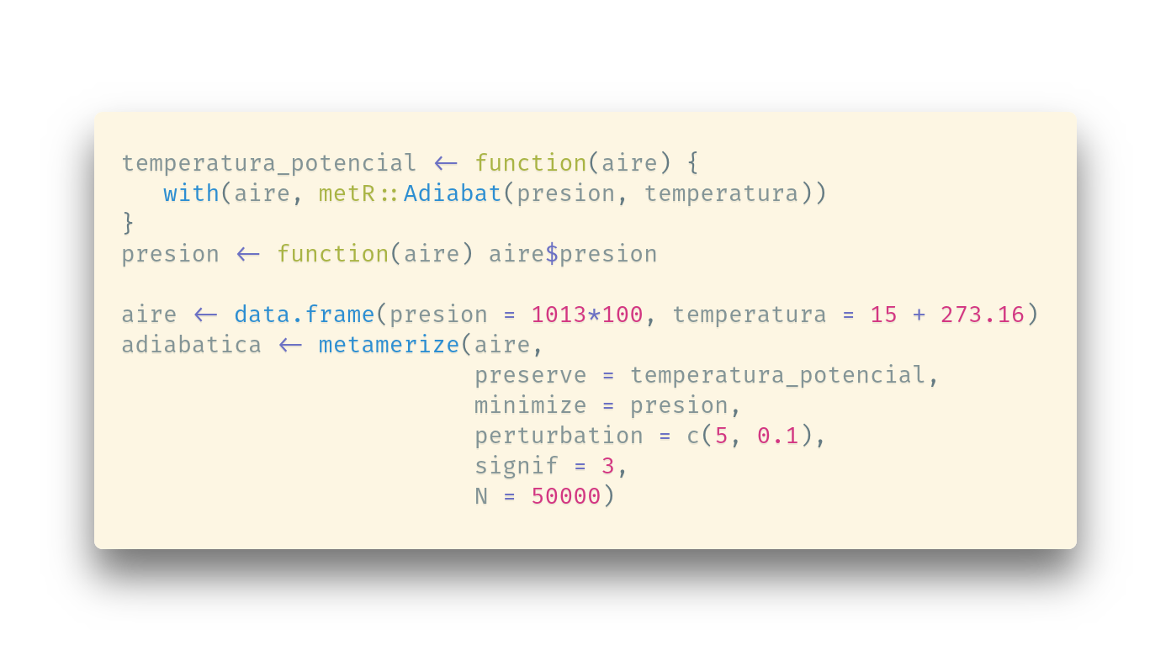

Slide 30
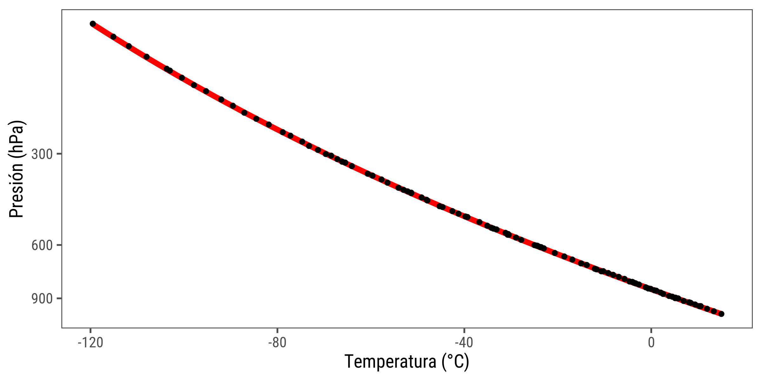

Slide 31
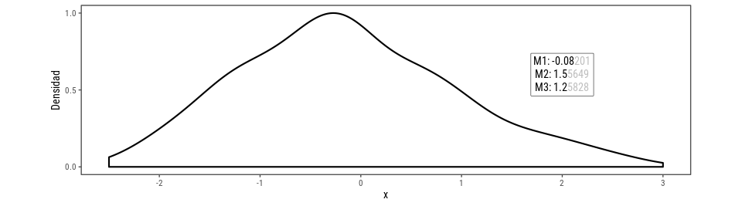

Slide 32
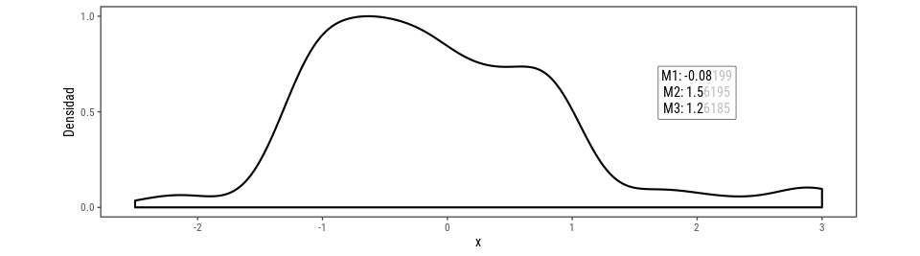

Slide 34
F es continua
¿?
F es inyectiva
m < n

Slide 35
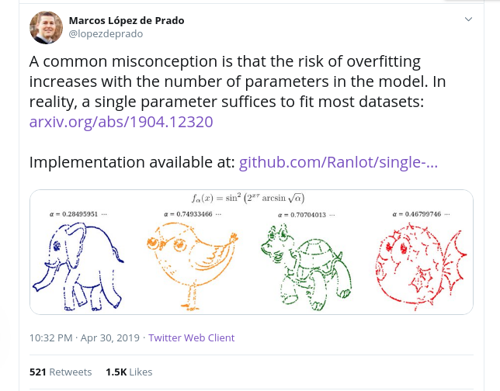

Slide 36
https://github.com/Ranlot/single-parameter-fit
https://github.com/eliocamp/spfit
\mathrm{datos} = \sin^2 \left ( 2^{x\tau} \arcsin \sqrt{\alpha} \right )

